Slide 1
Open Source Audio Platform: Ultrasound Dosimeter
Jennifer Cooper, Jordan Schleif, Adaleena Mookerjee,Tyler Flynn, O.H. Ott-Pietrak, Shane Lani
Dec 2, 2021
jennifer.cooper@jhuapl.edu
4aPP9

Slide 2
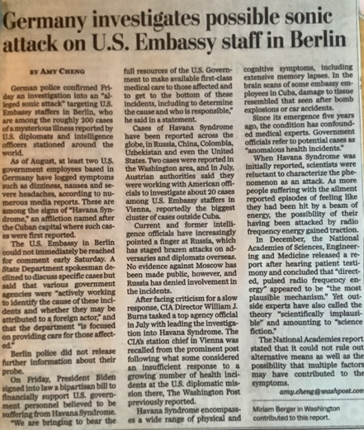
Motivation
Recent news articles suggest illness in diplomats caused by ultrasound
News media descriptions of the issue are muddled and difficult to assess
Washington Post, Oct 10, 2021

Slide 3
Motivation
Loud noise above 15kHz can cause annoyance, headaches, etc, especially in younger listeners
Others in the same space may not hear it
Auditory band differs among individuals
Sounds up to ~20 kHz can be observed in smartphone apps, but not far above that
Washington Post, Oct 10, 2021
Leighton, Lineton, Dolder, Fletcher, Acoustics Today, Fall 2020

Slide 4
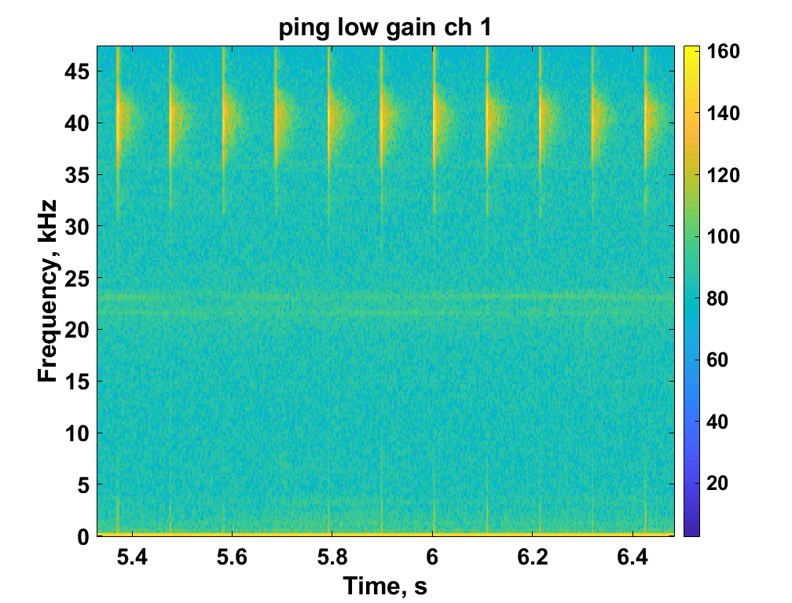
Project Overview
Create quick, easy, open source way to screen rooms for extraneous ultrasound across entire band
Higher frequencies than available on smartphone apps
User can listen to frequency shifted audio to help identify sources that are out of the ordinary
Would need to follow up with better (calibrated) tools if you found anything
Other questions we can answer with this work
Is my cat disturbed by high frequency sound coming from the TV? Why does he run away?
Can we hear bats in the neighborhood (work in progress)
Frequency shifted sounds are cool – scare the kids on Halloween!
Ultrasonic Ranger, 40 kHz Active Pings
Uncalibrated Levels, dB

Slide 5
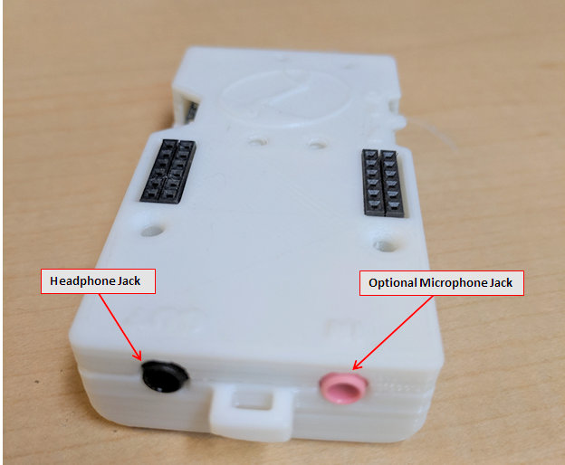
Approach
Use Arduino based open source Tympan platform
No circuits to build, just coding
Code can be shared for others to build on
Team includes acousticians and experienced C++ programmer
Compute 1/3 octave band levels
Compare high frequencies to lower frequencies
Alert if energy only at high frequency
Allow user to listen for themselves

Slide 6
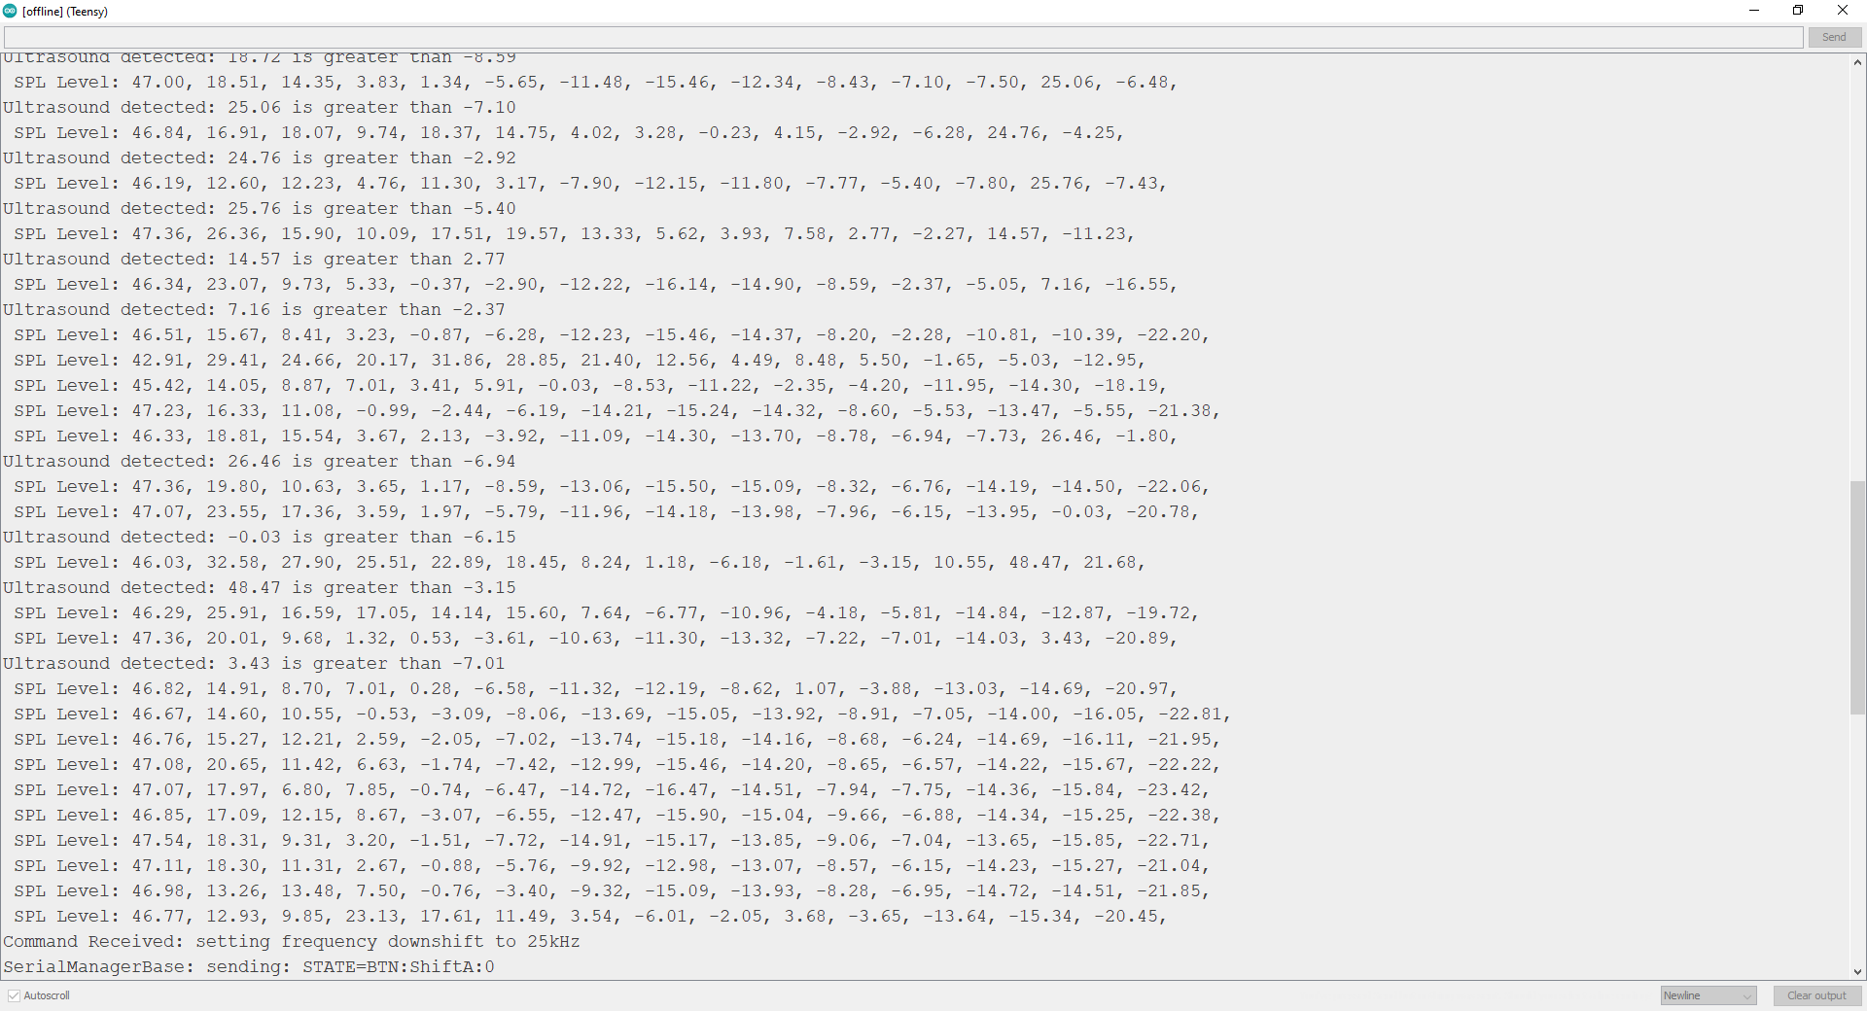
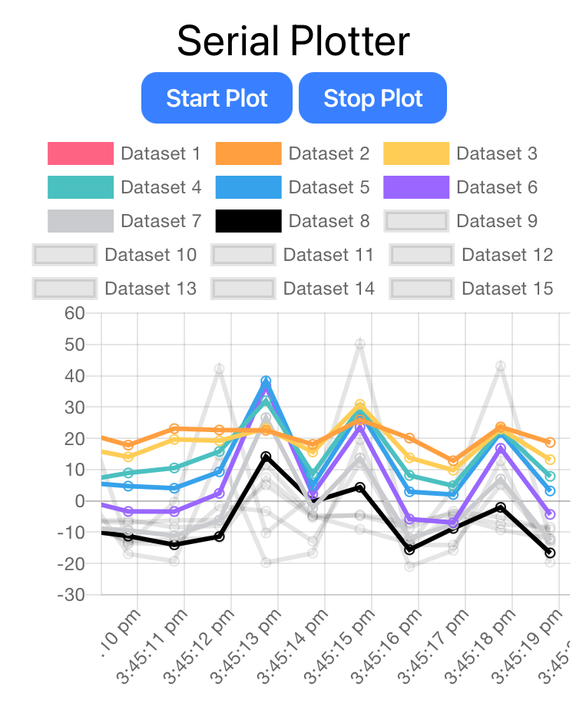
Compute (Uncalibrated) Octave Band Levels Below 20 kHz And 1/3 Octave Band Levels Above 20 kHz
Example Serial Monitor Output
Example Bluetooth App Plotter
1 Octave Frequency bands

Slide 7
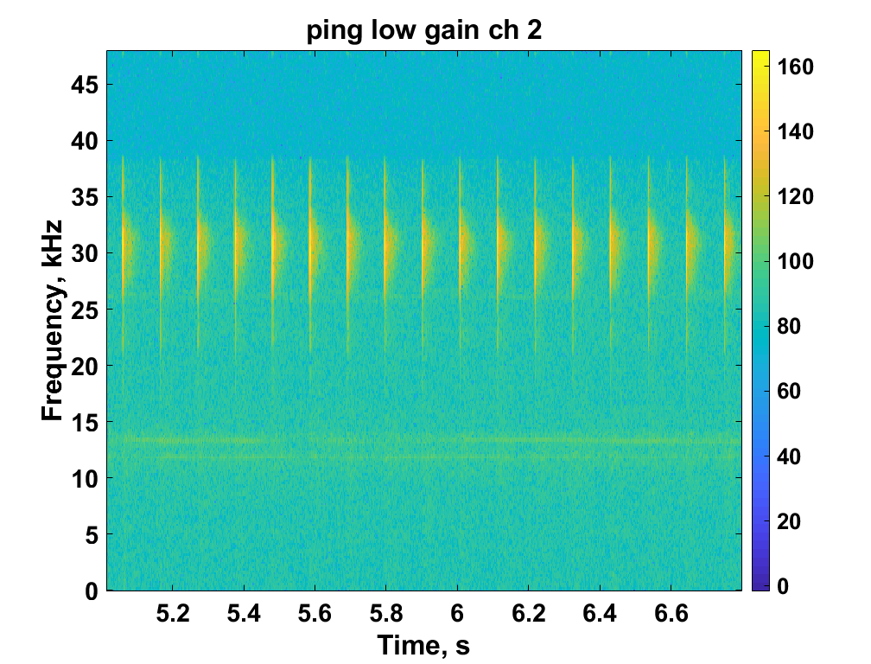
Play Back Through Headphone Jack
Ultrasound shifted down to audible in left channel and audio with low pass filter in the right channel
Record frequency shifted and raw audio to SD card (one on each channel in the .wav file) when user selects
Ultrasonic Ranger, 40 kHz Active Pings, Raw
Ultrasonic Ranger, 40 kHz Active Pings, -10kHz Freq Shift
Uncalibrated Levels, dB
Uncalibrated Levels, dB

Slide 8
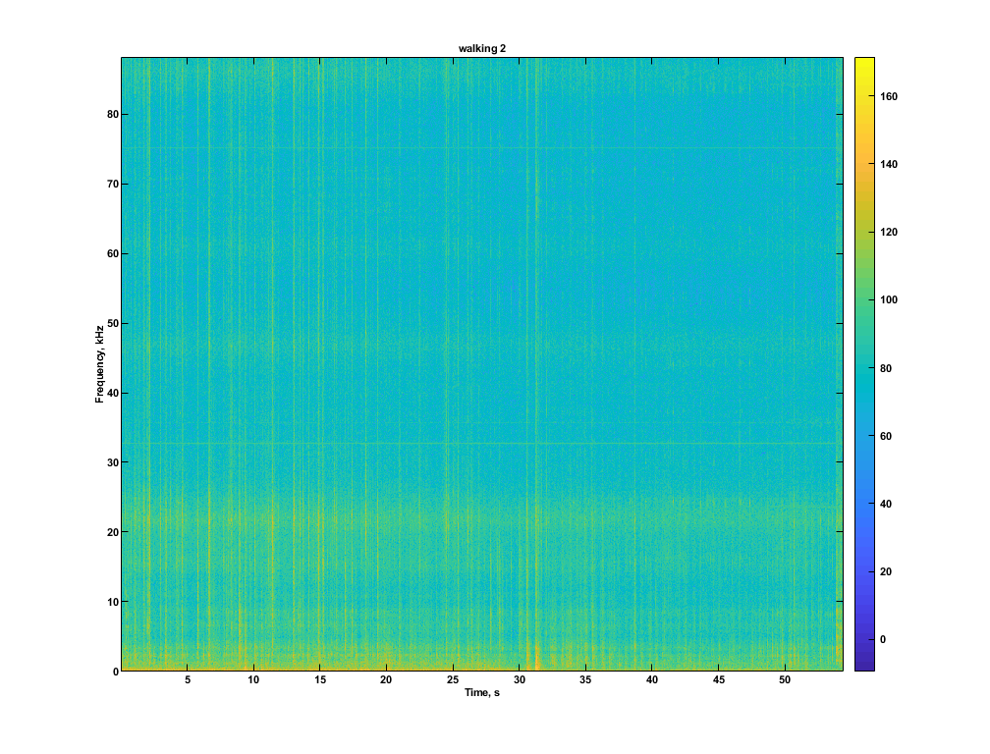
Alert If Irregular Ultrasonic Energy Is Observed
Alert = Flash the light and report to serial monitor
Threshold: level in any of the ultrasound 1/3 octave bands exceeds the level in the band just below 20kHz
Levels are averaged over the band and corrected back to spectral level units (dB/Hz)
Still uncalibrated, but the relative levels should be accurate
No Alert – Energy Above 20kHz is Related to Energy Below
Alert – High Frequency Energy NOT Related to Lower Frequencies

Slide 9
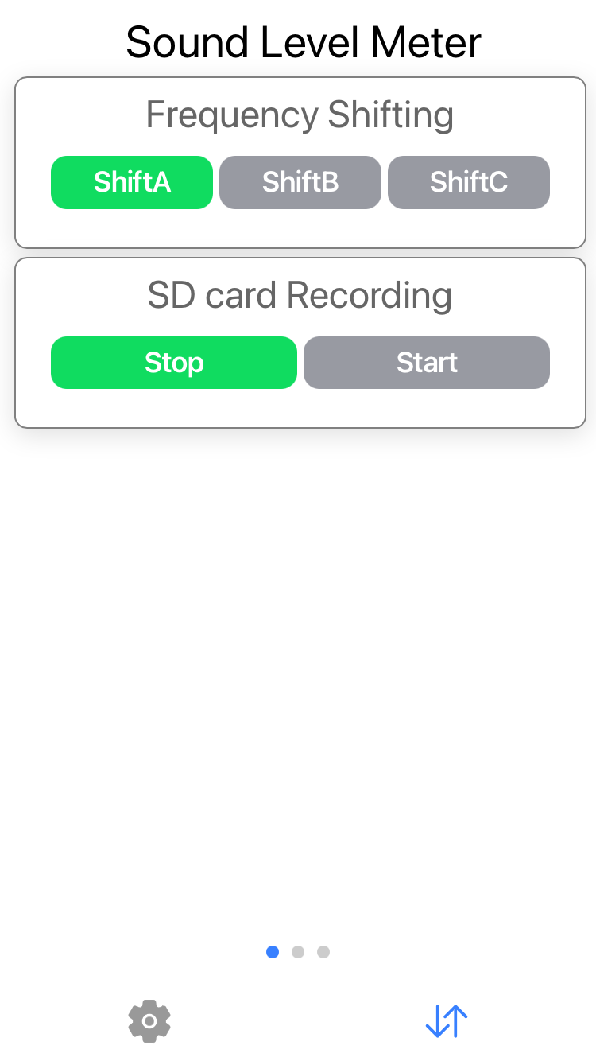
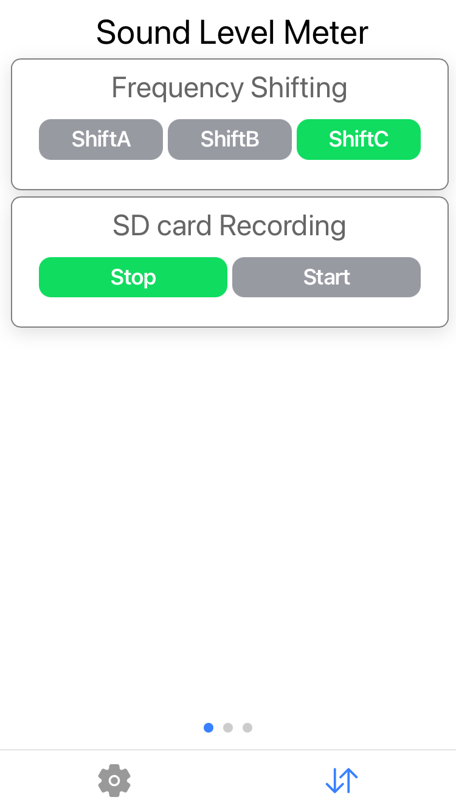
Bluetooth Controls
Tympan App on smartphone allows control over frequency shift (10, 20, 25 kHz) and SD card recording

Slide 10
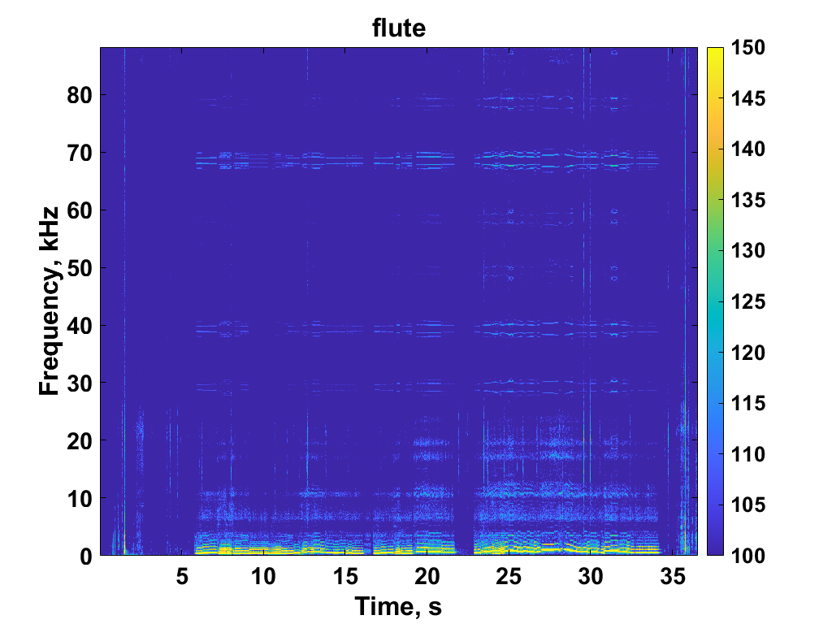
Lessons Learned
The Tympan has a configurable sample rate, enabled by sigma-delta ADC
But at sample rates > ~110kHz, it can’t really keep up, and spectral content is splattered
Spectrogram of a flute
Artifacts, 20 dB down
Uncalibrated dB levels
recorded at 176.4 kHz sample rate

Slide 11
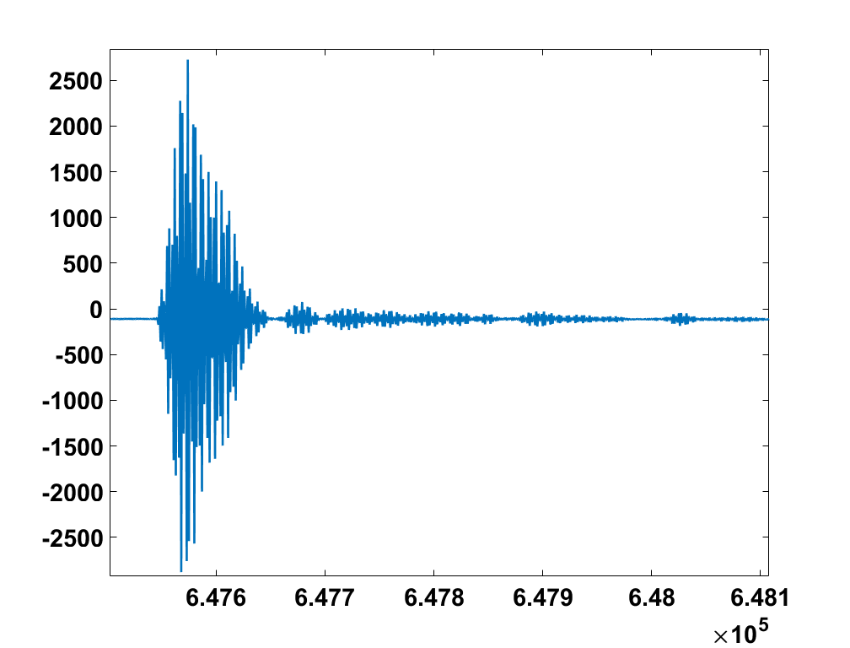
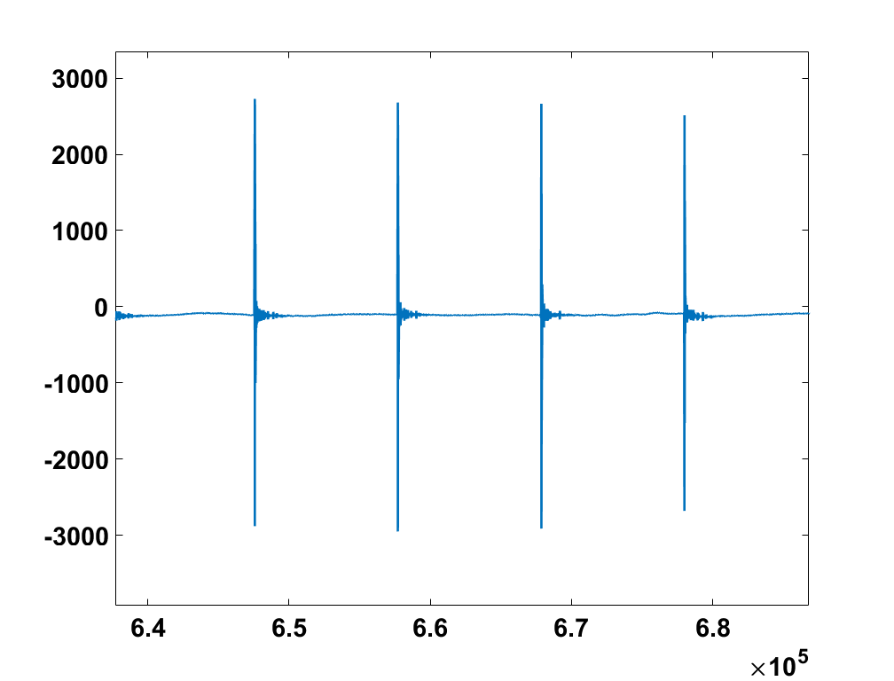
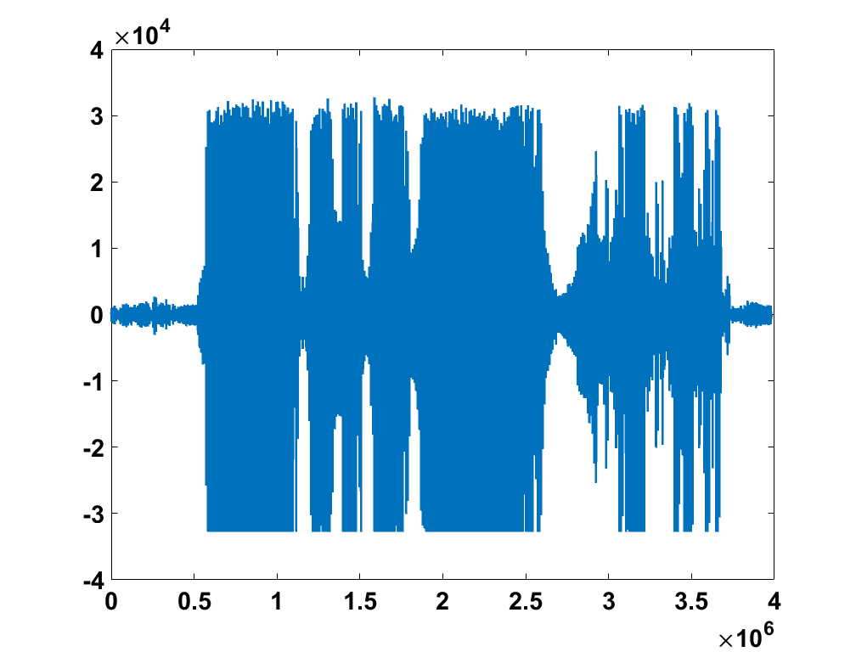
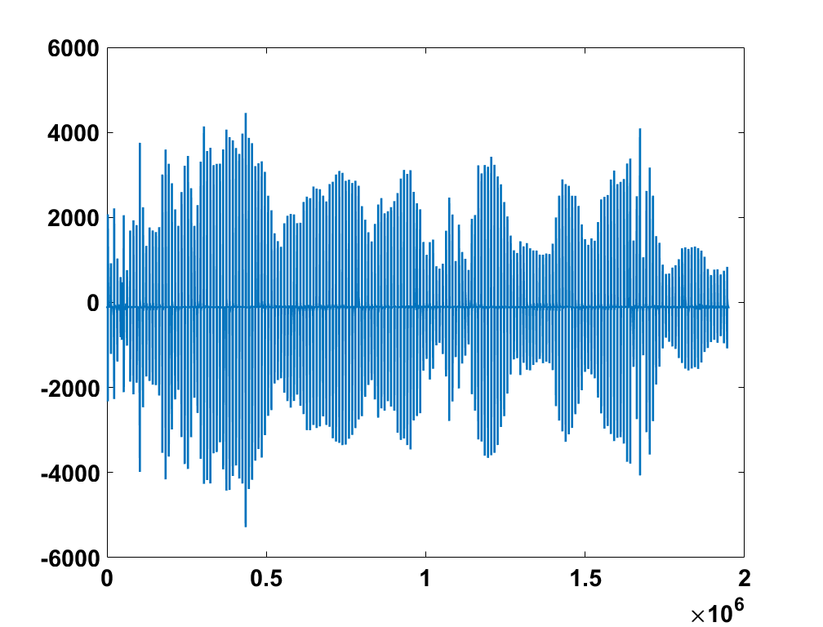
Lessons Learned
Using ultrasonic ranger for Arduino in initial tests, we heard clicks in audible band through the Tympan but not with our ears.
Adjusting the input gain to avoid saturation/clipping for an ultrasound source you can’t hear is difficult!
It was evident when looking at the recorded waveform
Ranger recorded with 25 dB input gain
Ranger recorded with 0 dB input gain
Uncalibrated Pressure
Clipping evident from the flat max level
Uncalibrated Pressure
Not Clipping
Time, in samples
Time, in samples
*Note difference in yaxis limits

Slide 12
Next Steps
Improve the threshold for questionable ultrasound levels
Ideally, would need access to something that looks like “ultrasonic weapons” to test against
Calibrate the built-in mic at ultrasound frequencies or use an external calibrated mic
Resonance peak typical in 20-40 kHz band for mics intended for audio
Need to adjust the threshold for alerting afterward
Improve the responsiveness
Processing in blocks means that if a transient sound does not align with the block, it may not register fully – energy will be split between blocks
Arduino works in a continuous loop, only acting on the blocks periodically. Again some transients will be missed

Slide 13

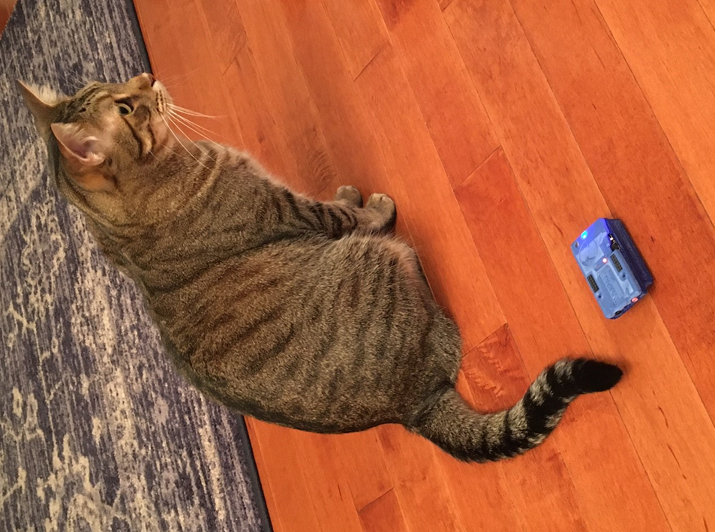
Fun With Frequency Shifting
Mild Mannered Scientist Becomes Feared Monster
Safety Pins Sound Awesome
Officemate Enhancement

